Slide 1
TYPES OF GRAPHS
There are many different graphs that people can use when collecting Data.
Line graphs, Scatter plots, Histograms, Box plots, bar graphs and pie charts.
Some work better to represent data that we collect better than others.

Slide 2
Does it ask if there is a correlation? Are two numbers or factors correlated
If so then you can use a Scatter plot or a Line Graph
Height vs Shoe Size. Scatter plot.
Something changing over time than use a Line Graph.

Slide 3
Scatter plots
Is the Fuel efficiency of a car related to Weight?
Are smoking rates correlated with medium income?
How are temperature and pressure related to a fixed volume?

Slide 4
Line Graphs
Have summer lake water temps increased over the last ten years?
How have the height of humans changes over the past century?

Slide 5
Does your question ask about the variability of a group of data points?
Such as the range of the data , the shape of the distribution, or what is the center of the data. Use Histograms, Dot plots or Box plot
Examples:
Do all high tides rise to the same height?
What is the range and distribution of the incomes in the United States?
How variable are wind speeds in Blaine?

Slide 6
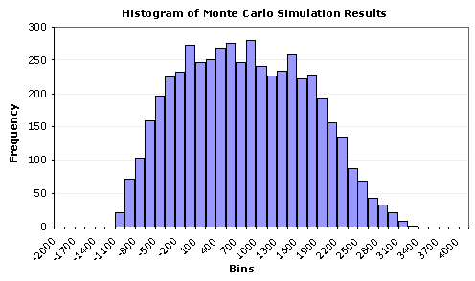
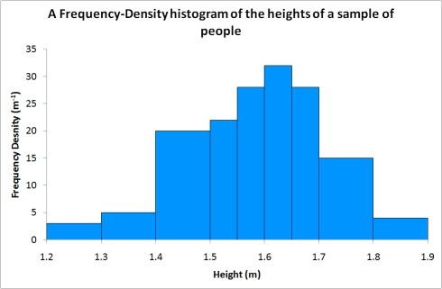
Histograms

Slide 7
Bar Graphs
Use these graphs if you are comparing single numbers.
Such as Median, Mean, or Total.
Was the snowfall greater this year compared to last winter?
How do Median incomes in the U.S. compare to the median incomes in Sweden?

Slide 8
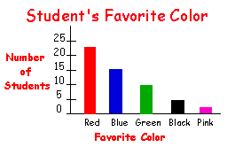
Bar Graphs

Slide 9
AP Biology Intro to Statistic

Slide 10
Beware the Danger of Averages!
Three statisticians went duck hunting. As a duck flew by, the first statistician shot at it, but was 10m too high. The second statistician shot at it, too, but was 10m too low. The third statistician exclaimed, “We got it!”

Slide 11
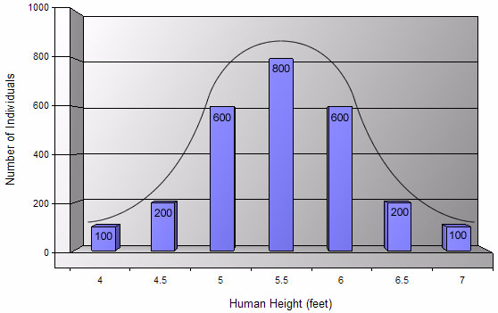
Statistics
Statistical analysis is used to collect a sample size of data which can infer what is occurring in the general population
More practical for most biological studies
Typical data will show a normal distribution (bell shaped curve)
Range of data
Two important considerations
How much variation do I expect in my data?
What would be the appropriate sample size?

Slide 12
Measures of Central Tendencies
Mean
Average of data set
Median
Middle value of data set
Not sensitive to outlying data
Mode
Most common value of data set
standard deviation
describes the variability in the data
standard error of the mean
determines your confidence in the sample mean.

Slide 13
Measures of Average
Mean: average of the data set
Steps:
Add all the numbers and then divide by how many numbers you added together
Example: 3, 4, 5, 6, 7
3+4+5+6+7= 25
25 divided by 5 = 5
The mean is 5

Slide 14
Measures of Average
Median: the middle number in a range of data points
Steps:
Arrange data points in numerical order. The middle number is the median
If there is an even number of data points, average the two middle numbers
Mode: value that appears most often
Example: 1, 6, 4, 13, 9, 10, 6, 3, 19
1, 3, 4, 6, 6, 9, 10, 13, 19
Median = 6
Mode = 6

Slide 15
Measures of Variability
Standard Deviation
It shows how much variation there is from the "average" (mean)
Lower standard deviation:
Data is closer to the mean
Greater likelihood that the independent variable is causing the changes in the dependent variable
Higher standard deviation:
Data is more spread out from the mean
More likely factors, other than the independent variable, are influencing the dependent variable

Slide 16
σ = standard deviation
68% of data fall within ±1s of mean
95% of data fall within ±2s of mean
99% of data fall within ±3s of mean

Slide 17
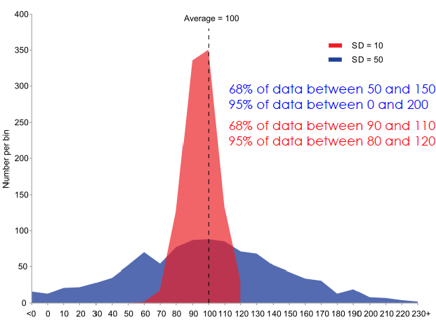
Actual data sets aren’t always so pretty...

Slide 18
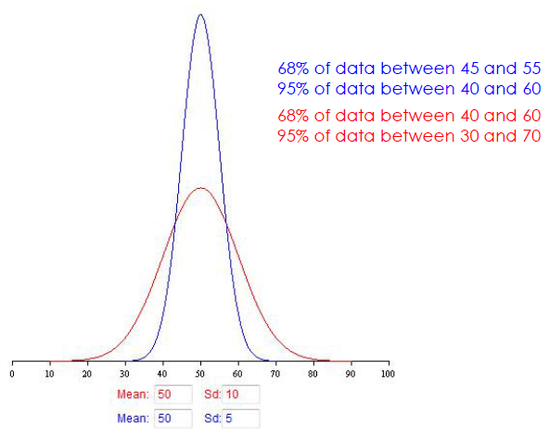
The magnitude of the standard deviation depends on the spread of the data set
Two data sets: same mean; different standard deviation

Slide 19
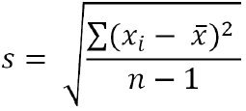
Calculating standard deviation, s
Calculate the mean (x)
Determine the difference between each data point, and the mean
Square the differences
Sum the squares
Divide by sample size (n) minus 1
Take the square root

Slide 20
Calculating Standard Deviation
Grades from a quiz
96, 96, 93, 90, 88, 86, 86, 84, 80, 70
1st Step:
find the mean (X)
Measure Number | Measured Value x | (x - X) | (x - X)²
1 | 96 | 9 | 81
2 | 96 | 9 | 81
3 | 92 | 5 | 25
4 | 90 | 3 | 9
5 | 88 | 1 | 1
6 | 86 | -1 | 1
7 | 86 | -1 | 1
8 | 84 | -3 | 9
9 | 80 | -7 | 49
10 | 70 | -17 | 289
TOTAL | 868 | TOTAL | 546
Mean, X | 87 | Std Dev

Slide 21
Calculating Standard Deviation
2nd Step:
determine the deviation from the mean for each grade then square it
Measure Number | Measured Value x | (x - X) | (x - X)²
1 | 96 | 9 | 81
2 | 96 | 9 | 81
3 | 92 | 5 | 25
4 | 90 | 3 | 9
5 | 88 | 1 | 1
6 | 86 | -1 | 1
7 | 86 | -1 | 1
8 | 84 | -3 | 9
9 | 80 | -7 | 49
10 | 70 | -17 | 289
TOTAL | 868 | TOTAL | 546
Mean, X | 87 | Std Dev

Slide 22
Calculating Standard Deviation
Measure Number | Measured Value x | (x - X) | (x - X)²
1 | 96 | 9 | 81
2 | 96 | 9 | 81
3 | 92 | 5 | 25
4 | 90 | 3 | 9
5 | 88 | 1 | 1
6 | 86 | -1 | 1
7 | 86 | -1 | 1
8 | 84 | -3 | 9
9 | 80 | -7 | 49
10 | 70 | -17 | 289
TOTAL | 868 | TOTAL | 546
Mean, X | 87 | Std Dev
Step 3:
Calculate degrees of freedom (n-1)
where n = number of data values
So, 10 – 1 = 9

Slide 23
Calculating Standard Deviation
Measure Number | Measured Value x | (x - X) | (x - X)²
1 | 96 | 9 | 81
2 | 96 | 9 | 81
3 | 92 | 5 | 25
4 | 90 | 3 | 9
5 | 88 | 1 | 1
6 | 86 | -1 | 1
7 | 86 | -1 | 1
8 | 84 | -3 | 9
9 | 80 | -7 | 49
10 | 70 | -17 | 289
TOTAL | 868 | TOTAL | 546
Mean, X | 87 | Std Dev | 8
Step 4:
Put it all together to calculate S
S = √(546/9)
= 7.79
= 8

Slide 24
Calculating Standard Error
So for the class data:
Mean = 87
Standard deviation (S) = 8
1 s.d. would be (87 – 8) thru (87 + 8) or 81-95
So, 68.3% of the data should fall between 81 and 95
2 s.d. would be (87 – 16) thru (87 + 16) or 71-103
So, 95.4% of the data should fall between 71 and 103
3 s.d. would be (87 – 24) thru (87 + 24) or 63-111
So, 99.7% of the data should fall between 63 and 111

Slide 25
Measures of Variability
Standard Error of the Mean (SEM)
Indication of how well the mean of a sample (x) estimates the true mean of a population (μ)
Measure of accuracy, if the true mean is known
Measure of precision, if true mean is not known
As SE grows smaller, the likelihood that the sample mean is an accurate estimate of the population mean increases

Slide 26
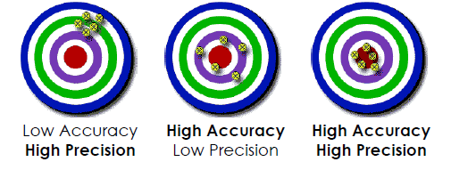
Accuracy – How close a measured value is to the actual (true) value
Precision – How close the measured values are to each other.

Slide 27
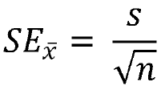
Calculating Standard Error, SE
Calculate standard deviation
Divide standard deviation by square root of sample size

Slide 28
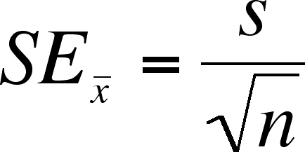
Calculating Standard Error
Using the same data from our Standard Deviation calculation:
Mean = 87
S = 8
n = 10
SE_{X} = 8/ √10
= 2.52
= 2.5
This means the measurements vary by ± 2.5 from the mean
Bozeman video: Standard Error

Slide 29
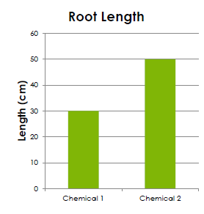
How do we use Standard Error?
Create bar graph
mean on Y-axis
sample(s) on the X-axis
chemical 1 mean = 30 cm
chemical 2 mean = 50 cm

Slide 30
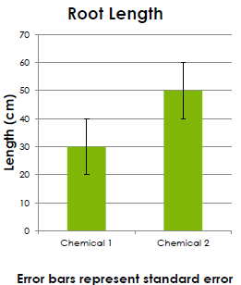
Add error bars!
± SE
Indicate in figure caption that error bars represent standard error (SE)

Slide 31
Analyze!
Look for overlap of error lines:
If they overlap: The difference is not significant
If they don’t overlap: The difference may be significant

Slide 32
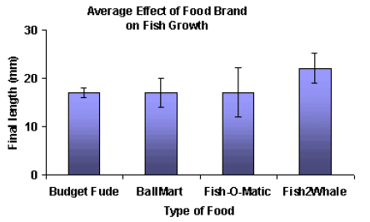
Which is a valid statement?
Fish2Whale food caused the most fish growth
Fish2Whale food caused more fish growth than did Budget Fude
✗
✓

Slide 33
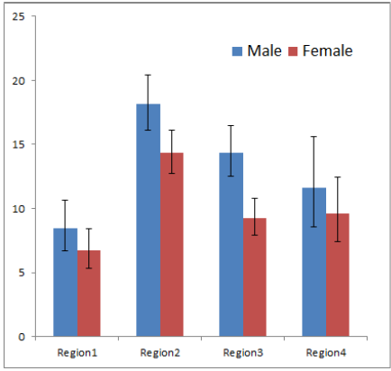
Statements:
In all four regions, more males exhibited the trait measured than did females.
More males in region 3 exhibited the measured trait than did females
✗
✓

Slide 34
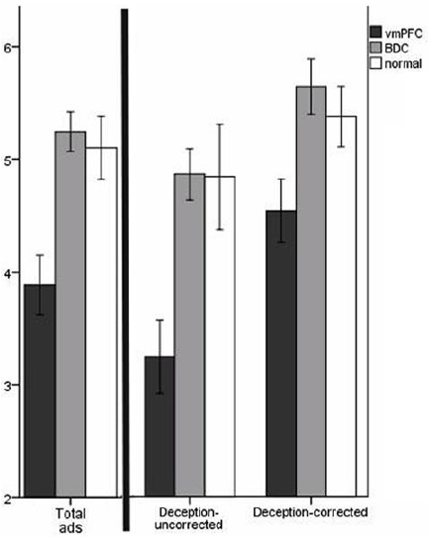
Mean belief scores for misleading ads
vmPFC = damage to ventromedial prefrontal cortex
BDC = brain damaged comparison group
Statements:
The vmPFC group identified fewer ads as misleading than did the normal group
The BDC group identified more ads as misleading than did the normal group.
# of ads identified as misleading
✓
✗

Slide 35
Consider these 3 plant populations:
When two SEM error bars don't overlap at all (like Pop. 1 and Pop. 3), and they are representing +/- 2 SEM, then you can be 95% confident there is a significant difference between the two populations (you can do other statistical tests to affirm this). (You can say, “the difference between Pop. 1 and Pop. 3 is significant at p<0.05”.)
When the +/- 2 SEM error bars do overlap but don't overlap the mean then you don't really know without a test--it might be or might not be a significant difference. Comparing Pop. 2 and Pop. 3 is this type of situation.
Finally, if the error bars overlap and that overlap includes the means, then you can be fairly confident there is no real difference. This is the situation comparing Pop. 1 and Pop 2.

Slide 36
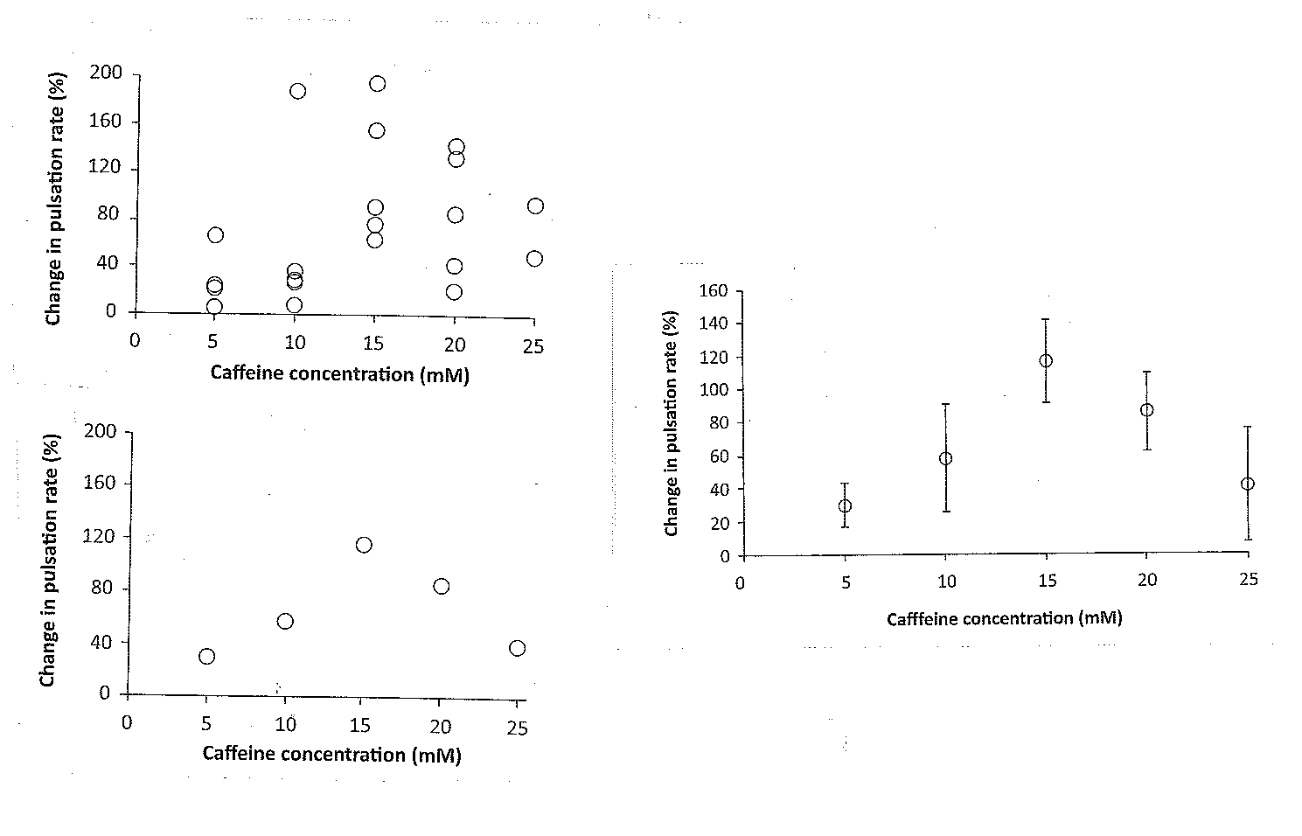
Little overlap, likely to be significantly different
So much overlap, may not be significantly different

Slide 37
